Slide 1

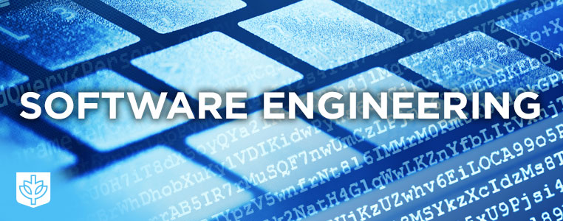
SE113
Lecture 2
Instructor:
Nusrat jahan
Lecturer, SWE, DIU.

Slide 2
Software Development Life Cycle (SDLC)
A software development lifecycle is essentially a series of steps, or phases, that provide a model for the development and lifecycle management of an application or piece of software.

Slide 3
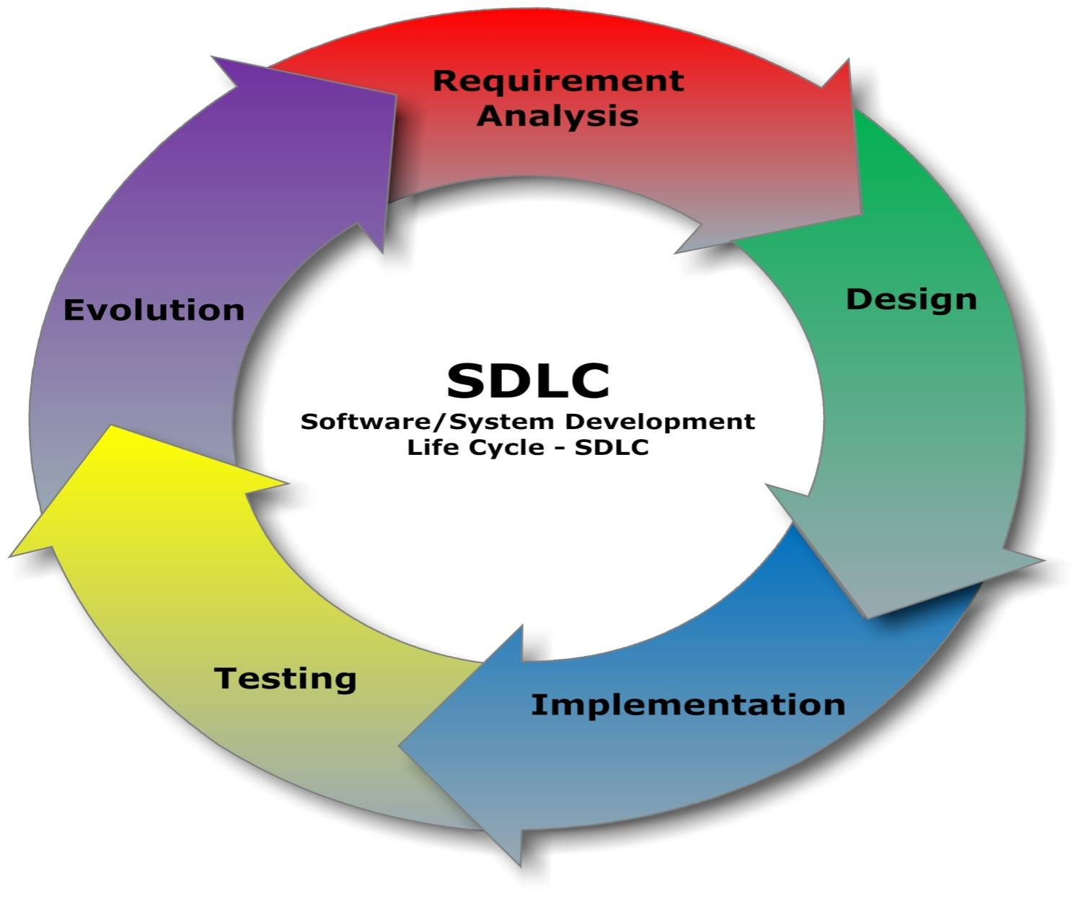
SDLC

Slide 4
Software Process
The road map that you follow is called a ‘software process’
The fundamental activities which are common to all software processes are:
Software specification
Software design and implementation
Software validation
Software evaluation.

Slide 5
Software development Model
Waterfall Model
Evolutionary Model
Spiral Model
Agile Model
Prototype Model
V-Model
Iterative Model

Slide 6
Waterfall model
Requirements
Definition
System & Software design
Implementation
& unit testing
Integration &
system testing
Operation &
Maintenances

Slide 7

Requirement gathering

Slide 8

Design

Slide 9

Coding

Slide 10

testing

Slide 11
Advantages of waterfall Model
Easy to understand, easy to use
Works well when quality is more important than cost or schedule
Documentation is produced at every stage of a waterfall model allowing people what has to be done
Testing is done at every stage

Slide 12
Disadvantages Of waterfall model
Complete Requirements Not Known at Project Start
Requirements are not stable/unchanging.
The design may need to change during implementation.
Errors in stages close to final state are more costly to solve
High Amount of Risks & Uncertainty.

Slide 13
Thanks

